Slide 1
Supercritical Water Upgrading of Crude Oil
Soumya Gudiyella
15th Oct 2015
1

Slide 2
CNMR of Asphaltene
Asphaltene fraction extracted from n-heptane
Diluted with CDCl3+TMS
Small peaks
Too much dilution?
d1=60 s, nt = 950
CDCl3
TMS

Slide 3
HNMR of Asphaltene
High TMS peak, high dilution
d1 = 3s, nt = 1000

Slide 4
Comparison with Crude Oil
Crude Oil Asphaltene
d1 = 1s, nt = 200
d1 = 3 s, nt = 1000

Slide 5
Comparison with Crude Oil
d1 = 1s, nt = 200
d1 = 3 s, nt = 1000

Slide 6
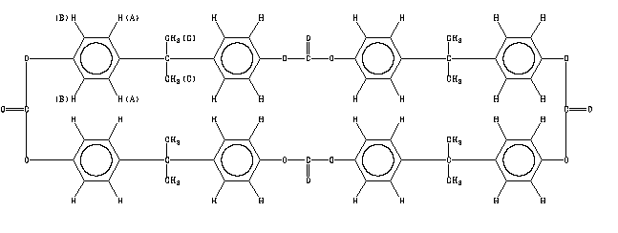
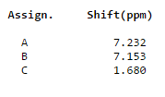
Possible compounds?

Slide 7
Next Steps
NMR
Better shimming/right conc. of solvent
Alcohols quantification in acqueous phase
Separation of aromatics from alkanes (contacted Griffin Group)
Alkene/alkynes quantification with different sample conc.

Slide 8
Back-up slides

